Slide 1
Introduction to Machine Learning and Its Applications
Mingxuan Sun
Associate Professor in Computer Science
Louisiana State University
May 2024

Slide 2
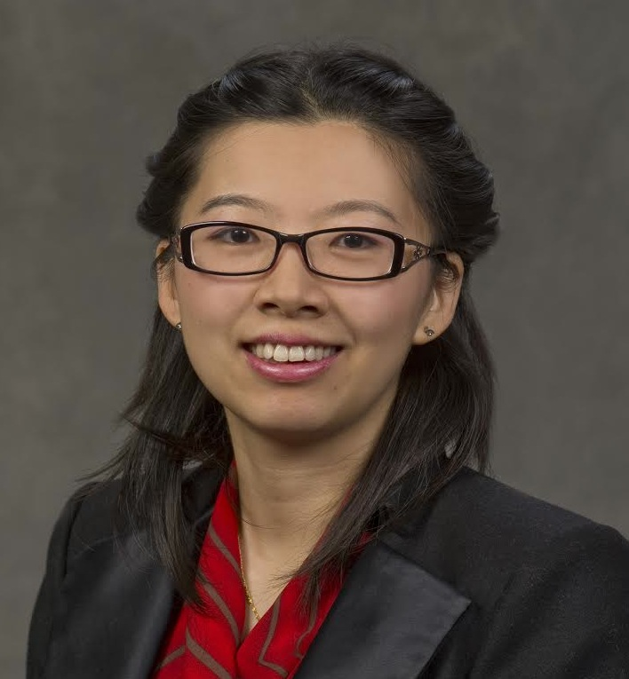
Mingxuan Sun
Associate Professor
Division of Computer Science and Engineering Louisiana State University
http://csc.lsu.edu/~msun/
Research interests:
Machine learning, Data mining, Sequence learning, Trustworthy AI
Research Sponsors:

Slide 3
What is Learning?
“A computer program is said to learn from experience E with respect to some class of tasks T and performance measure P, if its performance at tasks in T, as measured by P, improves with experience E ”
-Tom Mitchell

Slide 4
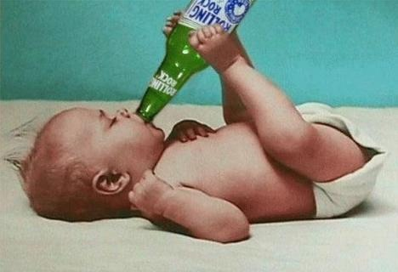
Learn from Data
To diapers: you may also like Beer!

Slide 5
History of Machine Learning
1990s — the “AI Winter”, a time of pessimism and low funding
But looking back, the ’90s were also sort of a golden age for ML research
Markov chain Monte Carlo
Variational inference
Kernels and support vector machines
Boosting
convolutional networks
reinforcement learning
2000s — applied AI fields (vision, NLP, etc.) adopted ML
2010s — deep learning
2010–2012 — neural nets smashed previous records in speech-to-text and object recognition
increasing adoption by the tech industry
2016 — AlphaGo defeated the human Go champion
2018-now — generating photorealistic images and videos I 2020 — GPT3 language model
Now — Trustworthy AI to increase attention to ethical and societal implications

Slide 6
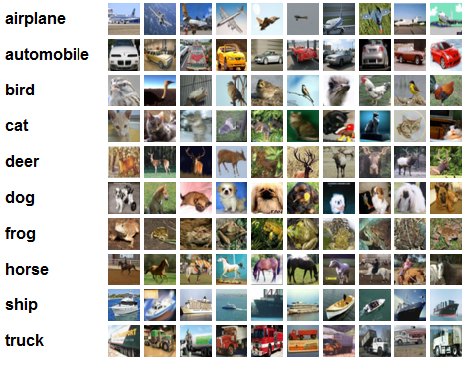
Computer Vision:
CIFAR 10 and Convolutional Neural Network
CIFAR 10 dataset:
50,000 training images
10,000 training images
10 categories (classes)
Accuracies from different methods:
Human: ~94%
K-Means: 74%
Whitening K-mean: 80%
……
Deep CNN: 95.5%
http://karpathy.github.io/2011/04/27/manually-classifying-cifar10/
https://www.kaggle.com/c/cifar-10/leaderboard

Slide 7
Playing Game

Slide 8
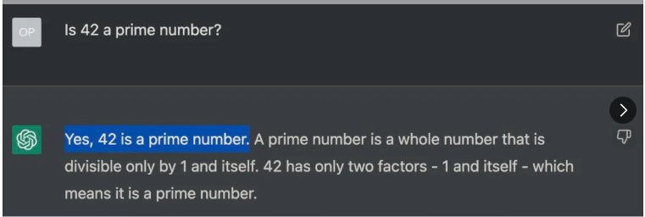
Large Language Model
Image courtesy reddit

Slide 9
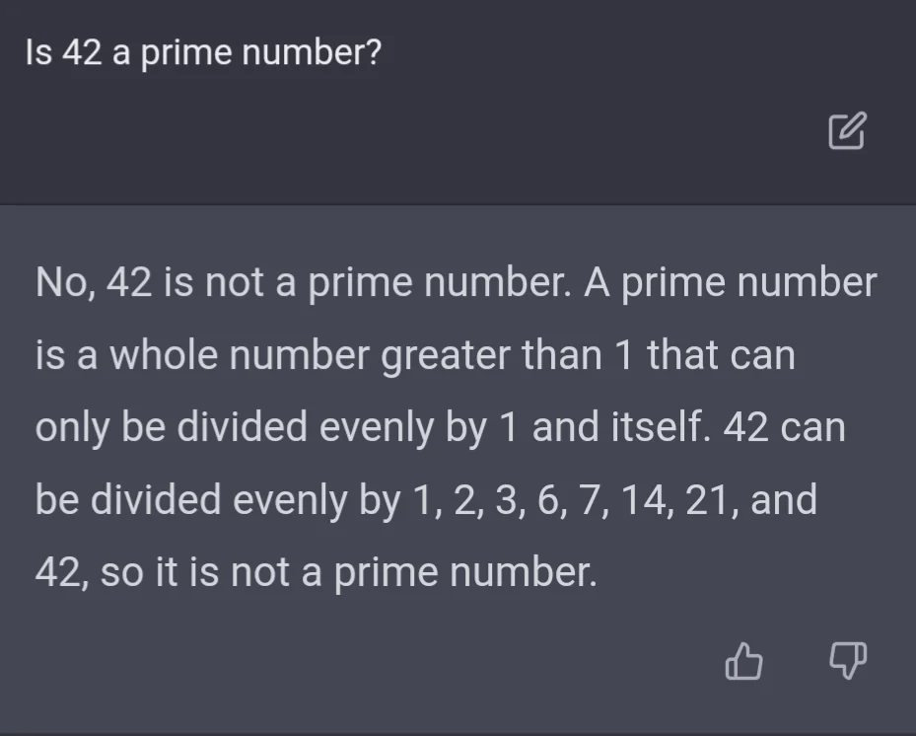
Large Language Model
Image courtesy reddit

Slide 10
DALL-E
Generate images from text
Prompt: “an armchair in the shape of an avocado…”
Slide courtesy cs.wisc.edu CS 760

Slide 11
Recommender System
Image courtesy of Netflix

Slide 12
Recommender System
Image courtesy of Amazon

Slide 13
Pandora (SiriusXM): Streaming Music Recommendation Engine
Content: Music Genome 450 distinct attributes such as genre, mood, tempo.
Collaborative: 70 Million User Thumbs (likes/dislikes/skips).

Slide 14
Model representation
Linear regression with one variable
Machine Learning
Slides adapted from Andrew Ng

Slide 15
Housing Prices
(Portland, OR)
Price
(in 1000s of dollars)
Size (feet²)
Supervised Learning
Given the “right answer” for each example in the data.
Regression Problem
Predict real-valued output

Slide 16
Training set of
housing prices
(Portland, OR)
Size in feet² (x) | Price ($) in 1000's (y)
2104 | 460
1416 | 232
1534 | 315
852 | 178
… | …
Notation:
m = Number of training examples
x’s = “input” variable / features
y’s = “output” variable / “target” variable

Slide 17
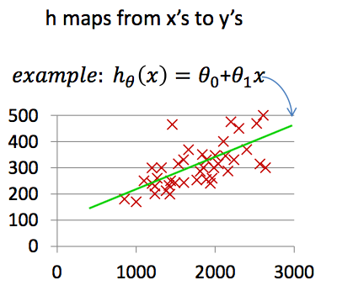
Training Set
How do we represent h ?
Learning Algorithm
Size of house
h
Estimated price
Linear regression with one variable.
Univariate linear regression.

Slide 18
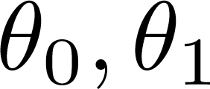
What is ?
=0
=1

Slide 19
What is ?
=0.5
=1

Slide 20
What is ?
=0
=2

Slide 21
What is ?
=1
=2

Slide 22
Cost function
Linear regression with one variable
Machine Learning
Slides adapted from Andrew Ng

Slide 23
Training Set
Size in feet² (x) | Price ($) in 1000's (y)
2104 | 460
1416 | 232
1534 | 315
852 | 178
… | …
Hypothesis:
‘s: Parameters
How to choose ‘s ?

Slide 24
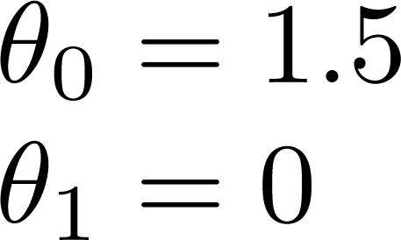
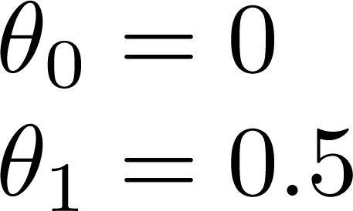
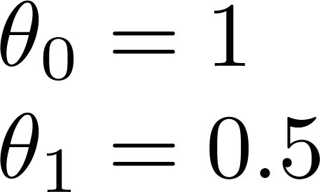

Slide 25
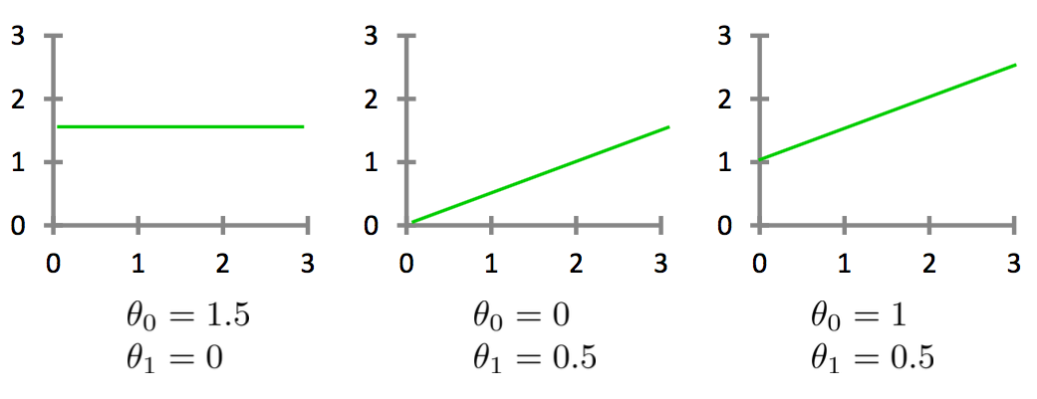
Which one of the 3 models fits the data best?

Slide 26
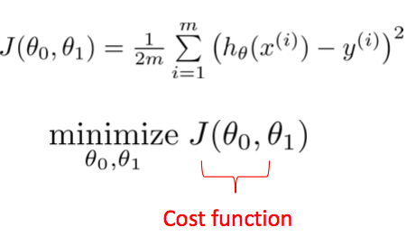
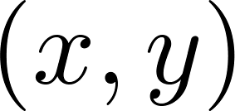
y
x
Idea: Choose so that is close to for our training examples

Slide 27
Cost function intuition I
Linear regression with one variable
Machine Learning
Slides adapted from Andrew Ng

Slide 28
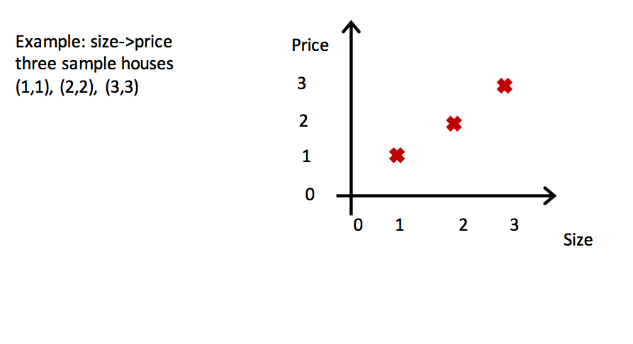

Slide 29
Simplified
Hypothesis:
Parameters:
Cost Function:
Goal:

Slide 30
(for fixed , this is a function of x)
(function of the parameter )
y
x

Slide 31
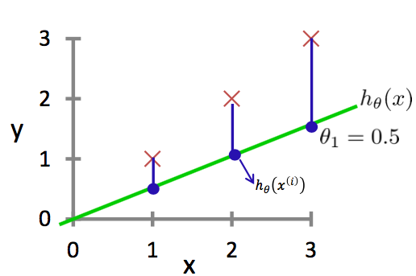
(for fixed , this is a function of x)
(function of the parameter )

Slide 32
(for fixed , this is a function of x)
(function of the parameter )
y
x
[(0-1)² + (0-2)² + (0-3)²]=2.3

Slide 33
(for fixed , this is a function of x)
(function of the parameter )
y
x

Slide 34
(for fixed , this is a function of x)
(function of the parameter )
y
x

Slide 35
(for fixed , this is a function of x)
(function of the parameter )
y
x
( -1)²+(2 -2)² + (3 -3)²
= 14( -1)²

Slide 36
Cost function intuition II
Linear regression with one variable
Machine Learning
Slides adapted from Andrew Ng

Slide 37
Hypothesis:
Parameters:
Cost Function:
Goal:

Slide 38
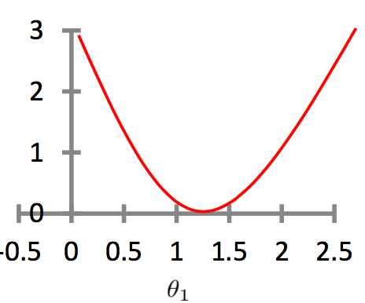
(for fixed , this is a function of x)
(function of the parameters )
Can not plot like this:
Price ($)
in 1000’s
Because we have two parameters.
Size in feet² (x)

Slide 39
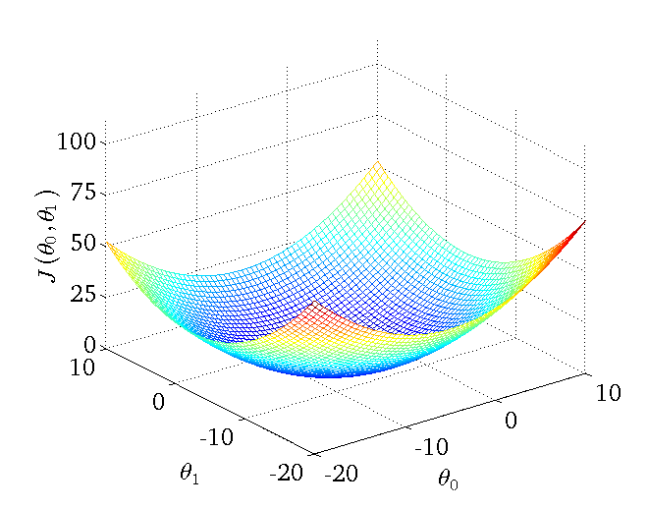

Slide 40
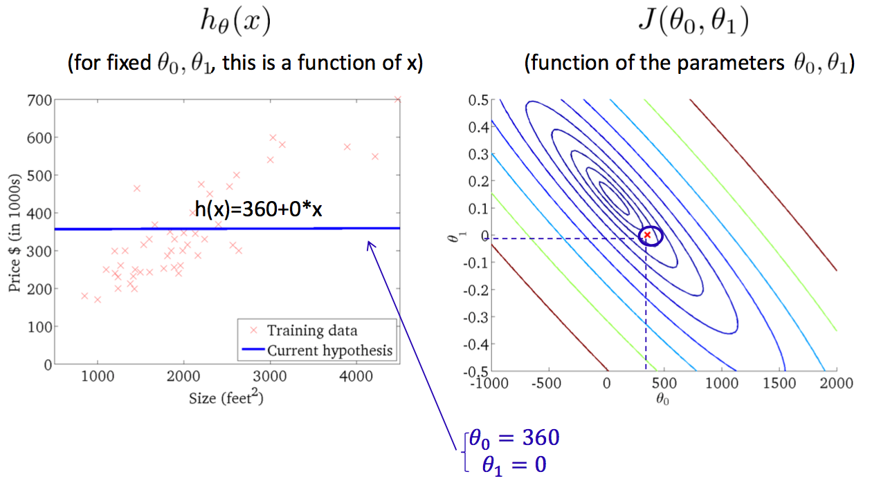
Contour Plot

Slide 41
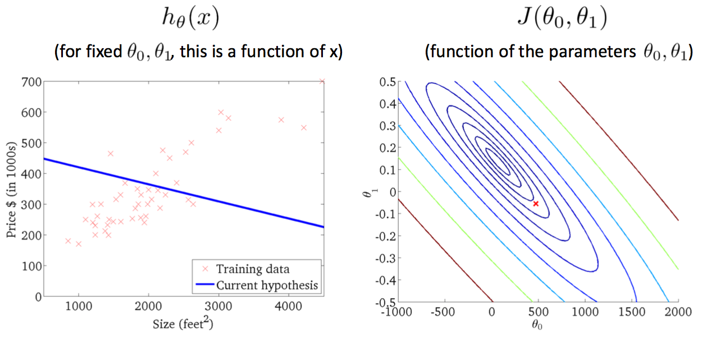

Slide 42
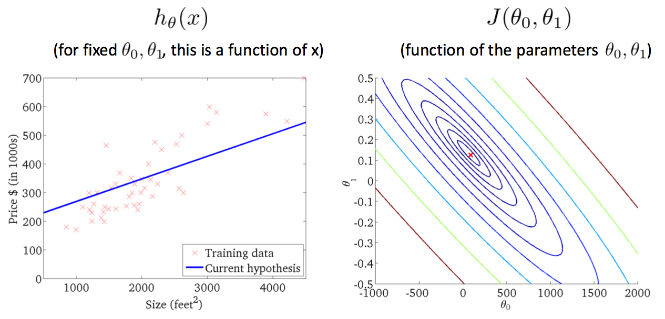

Slide 43
Linear Regression - Example
Which one below fits the data best?
y=2
y=x
y
y=0.5x
y=0.5x+0.5
y=0.5x+1
x
size (x) price (y)
1 1
2 1.5
3 2

Slide 44
Linear Regression - Example
Which one below fits the data best?
y=2
y=x
y
y=0.5x
y=0.5x+0.5
y=0.5x+1
x
size (x) price (y)
1 1
2 2
3 2

Slide 45
Linear Regression - Example
Which one below fits the data best?
y=2
(2-1)² + (2-2)² + (2-2)² =1
y=x
y
y=0.5x
y=0.5x+0.5
y=0.5x+1
x
size (x) price (y)
1 1
2 2
3 2

Slide 46
Linear Regression - Example
Which one below fits the data best?
y=2
(2-1)² + (2-2)² + (2-2)² =1
y=x
(1-1)² + (2-2)² + (3-2)² =1
y
y=0.5x
y=0.5x+0.5
y=0.5x+1
x
size (x) price (y)
1 1
2 2
3 2

Slide 47
Linear Regression - Example
Which one below fits the data best?
y=2
(2-1)² + (2-2)² + (2-2)² =1
y=x
(1-1)² + (2-2)² + (3-2)² =1
y
y=0.5x
(0.5-1)² + (1-2)² + (1.5-2)² =1.5
y=0.5x+0.5
y=0.5x+1
x
size (x) price (y)
1 1
2 2
3 2

Slide 48
Linear Regression - Example
Which one below fits the data best?
y=2
(2-1)² + (2-2)² + (2-2)² =1
y=x
(1-1)² + (2-2)² + (3-2)² =1
y
y=0.5x
(0.5-1)² + (1-2)² + (1.5-2)² =1.5
y=0.5x+0.5
(1-1)² + (1.5-2)² + (2-2)² =0.25
y=0.5x+1
x
size (x) price (y)
1 1
2 2
3 2

Slide 49
Linear Regression - Example
Which one below fits the data best?
y=2
(2-1)² + (2-2)² + (2-2)² =1
y=x
(1-1)² + (2-2)² + (3-2)² =1
y
y=0.5x
(0.5-1)² + (1-2)² + (1.5-2)² =1.5
y=0.5x+0.5
(1-1)² + (1.5-2)² + (2-2)² =0.25
y=0.5x+1
(1.5-1)² + (2-2)² + (2.5-2)² =0.5
x
size (x) price (y)
1 1
2 2
3 2

Slide 50
Linear Regression - Example
Which one below fits the data best?
y=2
(2-1)² + (2-2)² + (2-2)² =1
y=x
(1-1)² + (2-2)² + (3-2)² =1
y
y=0.5x
(0.5-1)² + (1-2)² + (1.5-2)² =1.5
y=0.5x+0.5
(1-1)² + (1.5-2)² + (2-2)² =0.25
y=0.5x+1
(1.5-1)² + (2-2)² + (2.5-2)² =0.5
x
size (x) price (y)
1 1
2 2
3 2

Slide 51
Linear Regression - Example
Which one below fits the data best?
y=2
(2-1)² + (2-2)² + (2-2)² =1
y=x
(1-1)² + (2-2)² + (3-2)² =1
y
y=0.5x
(0.5-1)² + (1-2)² + (1.5-2)² =1.5
y=0.5x+0.5
(1-1)² + (1.5-2)² + (2-2)² =0.25
y=0.5x+1
(1.5-1)² + (2-2)² + (2.5-2)² =0.5
x
size (x) price (y)
1 1
2 2
3 2
y=0.5x+0.67
square error=0.17

Slide 52
Linear Regression - Python
Colab link
https://colab.research.google.com/drive/1SlId2JEtmC53z3eVq6SYN4-htbzV2-1h?usp=sharing

